Slide 1

The Future of Cybersecurity: Adapting to an Evolving Threat Landscape
Presented by
Maimouna Diallo
Decaho
Abdoulaye Diallo
“Cybersecurity is much more than a matter of IT.” – Stephane Nappo

Slide 2

Introduction
Cybersecurity impacts every industry, from healthcare to finance. It has become a cornerstone of the digital age, protecting businesses, governments, and individuals from cyber threats.
Rapid digital transformation has exposed vulnerabilities in systems worldwide. New and evolving threats challenge traditional defenses.
Question: How will cybersecurity evolve to meet future challenges?

Slide 3
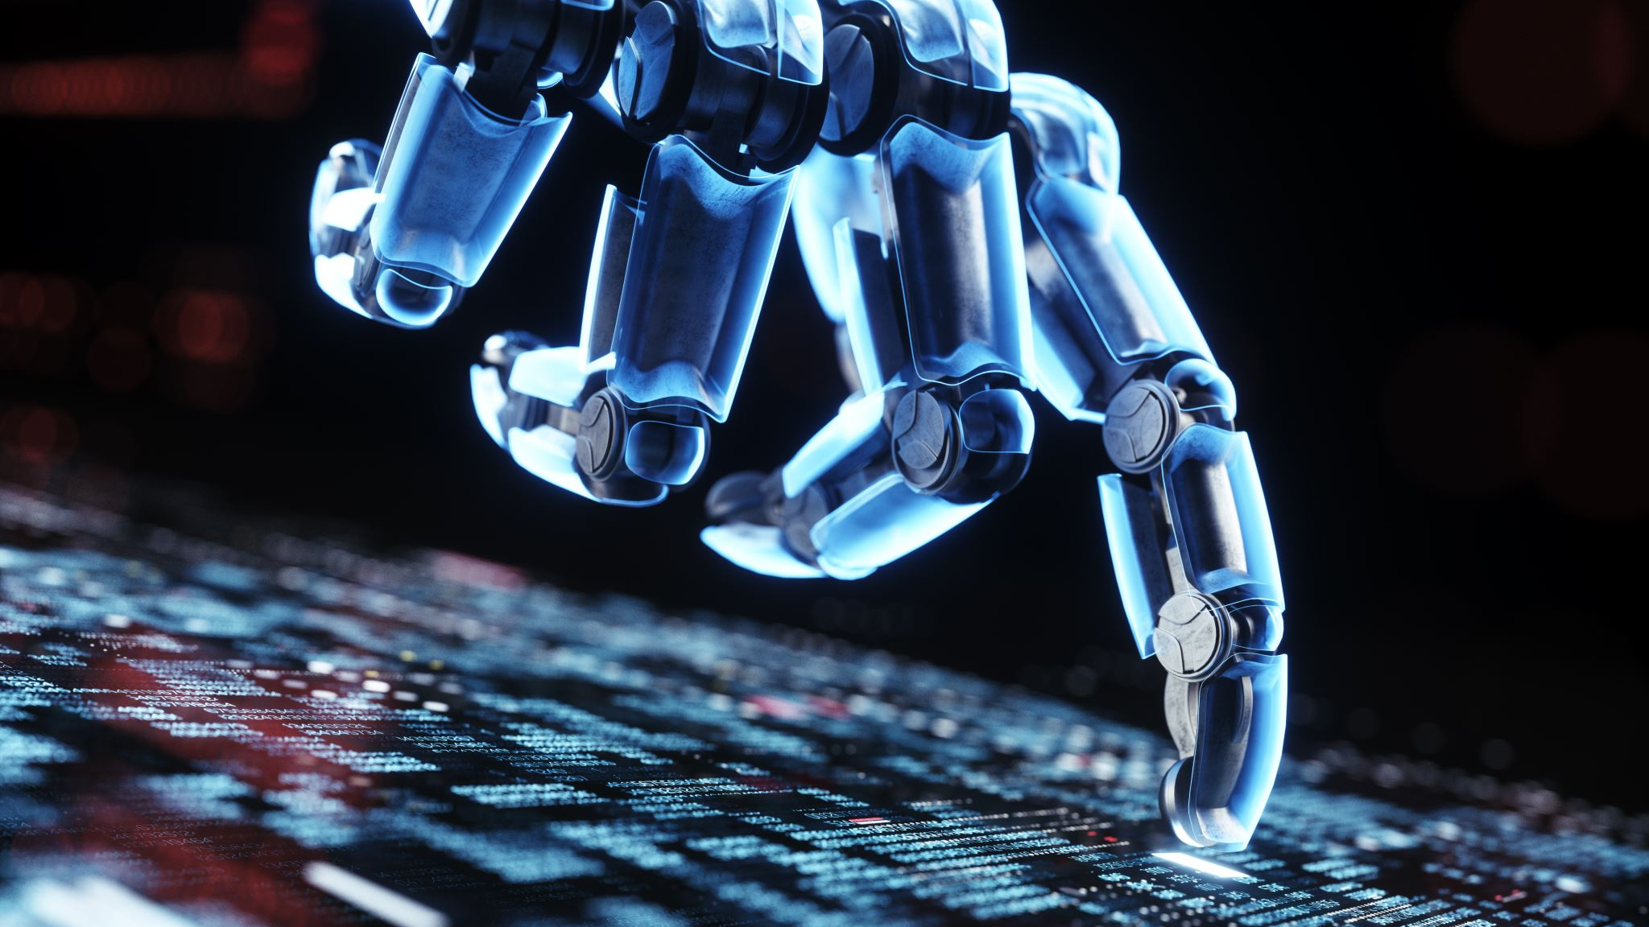
Emerging Threats in Cybersecurity
AI-Powered Attacks:
Hackers are leveraging AI for smarter malware and phishing campaigns, making attacks harder to detect. Deepfake phishing scams tricking companies into transferring millions.
Quantum Computing Risks:
Quantum technology could potentially break widely-used encryption, threatening sensitive data. Estimated timeline for quantum decryption threats to occur: 10-20 years.
Advanced Persistent Threats (APTs):
State-sponsored actors targeting critical infrastructures like power grids and financial systems. Russian APT group targeting energy sectors in the U.S. and Europe.
Cybercrime damages are projected to cost the world $10.5 trillion annually by 2025.

Slide 4
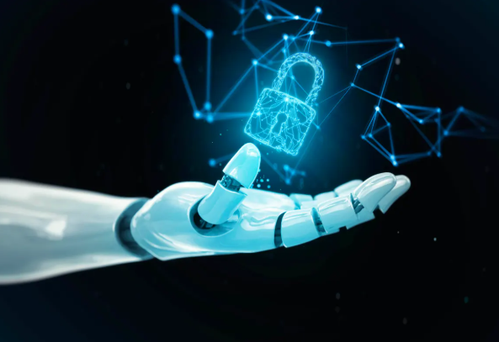
The Role of AI and Automation in Cybersecurity
“AI is not just about creating efficiency; it’s about creating new capabilities to anticipate and address emerging threats.” – Satya Nadella
Proactive Defense: AI can analyze vast amounts of data to detect anomalies and prevent attacks in real-time.
Automated Threat Hunting: Automation identifies vulnerabilities faster than manual processes.
Risks of AI Misuse: Attackers could use AI to create undetectable malware.
Ethical dilemmas arise in over-reliance on automation. ChatGPT-style tools could create malware scripts if misused.
"AI is both a sword and a shield in cybersecurity."

Slide 5

The Future is Zero Trust
“Zero trust assumes breach and verifies every access request as though it originates from an open network.” – NIST (National Institute of Standards and Technology)
Verify Everything: No user or device is trusted by default, even if inside the network.
Continuous Monitoring: Real-time analysis to detect unusual behaviors.
Micro-Segmentation: Breaking the network into isolated zones to prevent lateral attacks. (Reduced lateral movement and limited access to sensitive data.)

Slide 6

Google implemented Zero Trust (BeyondCorp) to protect internal systems.
BeyondCorp is Google's implementation of the Zero Trust security model, designed to:
Replace traditional VPN-based access with a more granular approach.
Provide secure access to internal applications and systems based on user and device trust, not network location.
The framework was developed following a series of high-profile attacks on Google, including the 2010 Aurora attack, which highlighted vulnerabilities in traditional security architectures.
Benefits of BeyondCorp
Enhanced Security:
Reduces the risk of lateral movement by attackers within a network.
Protects against insider threats and compromised devices.
Improved User Experience:
Eliminates the need for VPNs, enabling seamless access from anywhere.
Supports remote work without sacrificing security.
Scalability and Flexibility:
Easily integrates with cloud-based applications and modern IT environments.
Simplifies the management of a distributed workforce.

Slide 7

Preparing for a Quantum Future
Quantum computers excel in factoring large prime numbers, which threatens RSA encryption.
Quantum Threats: Classical encryption methods like RSA and ECC could be rendered obsolete.
Quantum-Safe Solutions: Post-quantum cryptography is being developed to counteract these risks.
Governments and organizations must begin testing and implementing quantum-resistant protocols now.

Slide 8
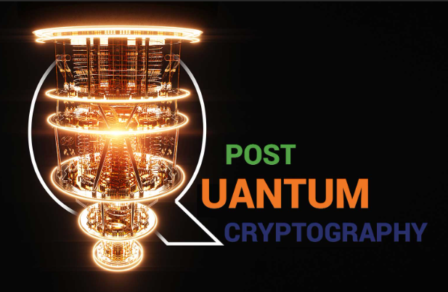
the National Institute of Standards and Technology (NIST) running a competition for post-quantum cryptography algorithms.
Goals of the Competition
Develop cryptographic algorithms secure against both classical and quantum computers.
Ensure these algorithms are practical and efficient for a variety of applications.
Create a robust standard for public-key cryptography in the quantum era.
Phases of the Competition
The competition has progressed through several phases:
Submission and Initial Evaluation (2017–2019): Researchers submitted 69 candidate algorithms. These were evaluated based on security, efficiency, and implementability.
Round 2 (2019–2020): The pool was narrowed to 26 algorithms.
Round 3 (2020–2022): Finalists and alternate candidates were selected for in-depth analysis. NIST selected four algorithms in July 2022 for standardization:
CRYSTALS-Kyber (for public-key encryption and key establishment).
CRYSTALS-Dilithium, FALCON, and SPHINCS+ (for digital signatures).
Current Status (2024)
The four selected algorithms are in the process of being standardized.
NIST is also continuing its evaluation of alternate candidates for potential inclusion in future standards.

Slide 9

Importance of Global Collaboration
Cybersecurity is a global challenge requiring cooperation between countries and organizations.
Threat intelligence sharing helps predict and prevent attacks.
International frameworks like GDPR or NIST and cybersecurity treaties can promote standardization and accountability.
Example: The takedown of the Emotet botnet in 2021 was a collaborative effort among law enforcement agencies from several countries.

Slide 10
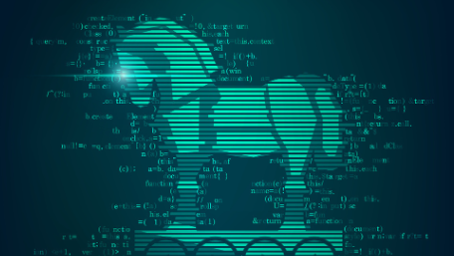
What Was Emotet?
Emotet was responsible for a significant portion of global malware infections. Its takedown caused a ripple effect, reducing the reach of other criminal operations dependent on its infrastructure.
Origin: First discovered in 2014 as a banking trojan, Emotet evolved into one of the most sophisticated and destructive botnets.
Functionality: Known for distributing other malware, such as ransomware (e.g., Ryuk) and banking trojans (e.g., TrickBot), Emotet was a "malware-as-a-service" platform for cybercriminals.
Scale: It infected millions of devices worldwide, enabling credential theft, financial fraud, and large-scale ransomware attacks.

Slide 11
The Takedown
The operation to dismantle Emotet was unprecedented in scale and complexity.
Collaborating Countries
Agencies from Germany, the Netherlands, the United States, the United Kingdom, Canada, France, Lithuania, and Ukraine, among others, participated in the effort.
Europol and Eurojust played coordinating roles.
How It Happened
Infrastructure Seizure:
- Investigators gained control of Emotet's servers and redirected them to an infrastructure controlled by law enforcement.
- This allowed authorities to disrupt communications between infected devices and the botnet operators.
Malware Cleanup:
- A specially crafted update was distributed to infected machines, disabling the Emotet malware and preventing it from further spreading or being exploited.
Arrests:
- Several individuals linked to the botnet's operation were arrested, including a key suspect in Ukraine.
Evidence Collection:
- Servers seized during the operation contained information about victims and the botnet's activities, providing valuable intelligence for future investigations.

Slide 12

Lessons
International Cooperation is Key
Cybercrime transcends borders, and the success of this operation underscored the importance of collaboration among nations.
Persistent Threat
Despite the takedown, other botnets and malware platforms remain active. This highlights the need for continuous vigilance and adaptability in cyber defense strategies.
Public Awareness
Educating organizations and individuals about phishing and malware can prevent the initial infections that enable botnets like Emotet to thrive.

Slide 13
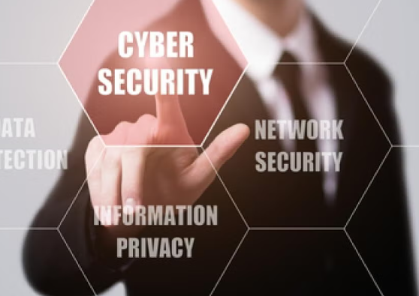
Cybersecurity Workforce of the Future
Rising Demand: The cybersecurity workforce gap is expected to exceed 3.4 million globally.
Continuous Learning: Professionals need to stay updated on the latest technologies and threats.
Diversity in Teams: Diverse teams lead to innovative problem-solving.
programs like CyberStart and partnerships such as Cisco Networking Academy for workforce development.
Call to Action: "Invest in certifications, education, and diversity to secure the future."

Slide 14
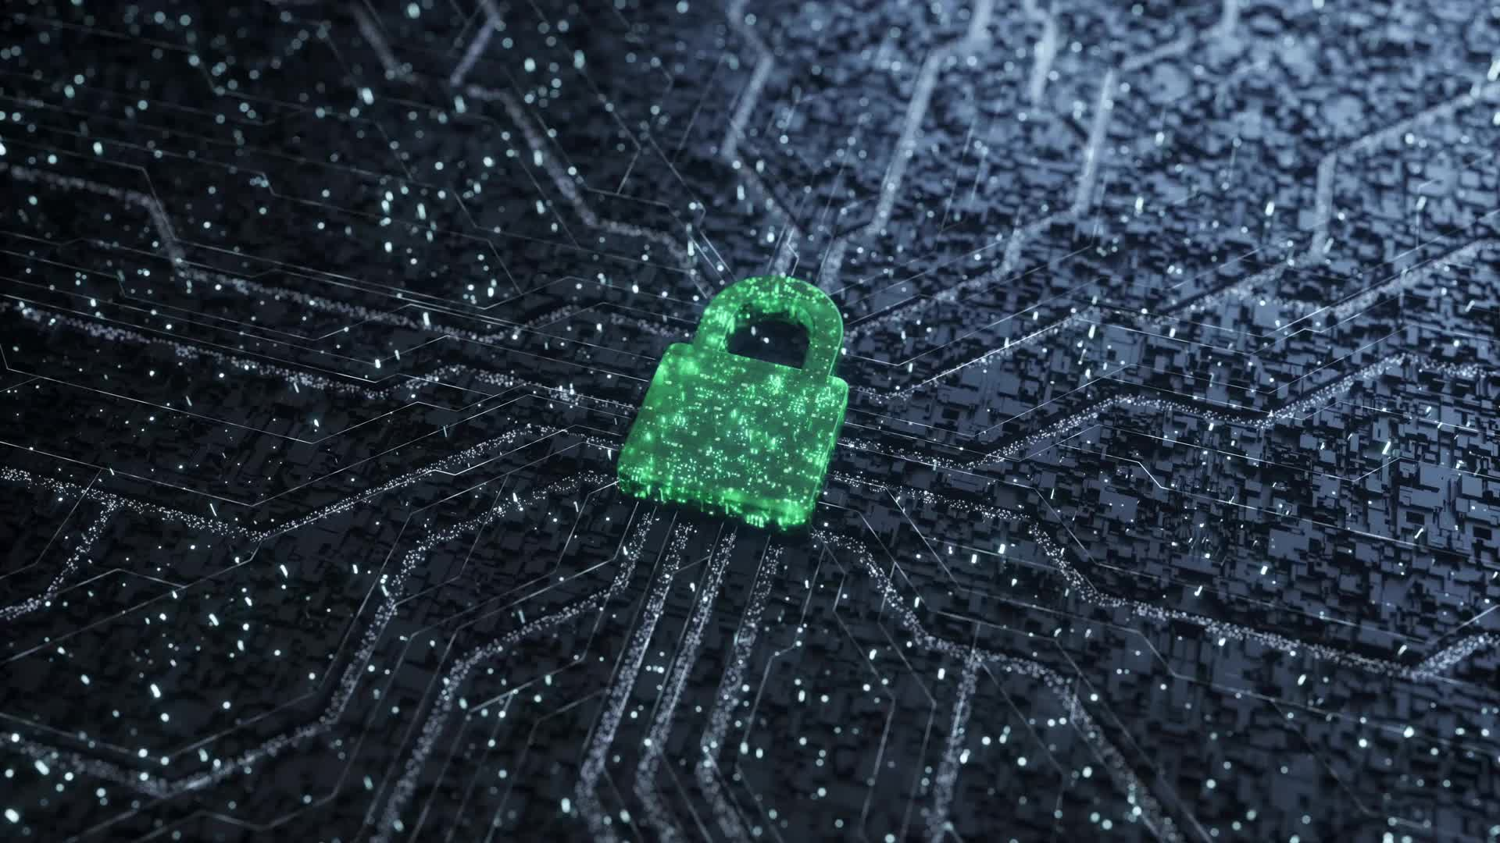
Conclusion
Cybersecurity is an evolving field shaped by new technologies and threats.
Awareness, innovation, global collaboration, and proactive defense strategies are very important.
"With the right strategies, the future of cybersecurity can be secure and innovative."

Slide 15

Questions?

